Slide 1
CLIMATES OF THE PACIFIC NORTHWEST (mouse over box in lower right for audio access. All slides have audio)
Notes:
Couer D’ Alene Lake looking west

Slide 2
Is there something that all Pacific Northwest climates have in common?
general impressions of early “settlers”:
dry summers, wetter winters?

Slide 3
General PNW Climate Controls
mid-latitude west coast location, compared with others globally: among the driest summers
Pacific Ocean influences: source of moisture, moderates temperature
North American continent influences: contributes to extremes in temps. and dry air masses
role of surface topography: N-S mountains play key role
surface topography and situation in relation to above factors make for local variations in climates

Slide 5
Climatic Elements
General Winds and Pressure: (see Atlas)
Pacific High – dominant in summer (dry); Westerlies & mid-latitute cyclones in winter (wet, low pressure)
2. Temperature: general patterns N to S differences slight, E-W differences large
(summer highs: E-W dif ~20°F, N-S 10°F)
(winter lows: E-W diff ~25°F, N-S 10°F) example:
Brookings (coast) Jan mean 48°, July 59°
Rome (SE OR): 29° and 72°

Slide 6
PNW Temp (con’t.)
monthly max reached in interior in late July
mean for daily maximum temps. reached on north coast in Aug and south coast in Sept.

Slide 7
PNW Precipitation
lifting necessary for precipitation: rising air cools and may reach its dewpoint → condensation → precipitation
3 ways that the atmosphere is lifted
frontal/mid latitude cyclones (low pressure), (peak effect in winter) 2 minute video
orographic/topographic (no seasonality per se)
coastal hills: 1” annual precip. increase for each 50’ rise
convective (mostly May through Oct heating, peaking in summer) affects interior areas most (often thunderstorms)
Also, remember that moisture is necessary for precipitation.
moisture sources: __________ and __________
e interaction of the previous three factors shapes the geographic & temporal variation in precipitation

Slide 8
PNW Precipitation (cont)
general temporal pattern: winter wet, summer dry. Winter is dominated by mid-latitude cyclones, summer by high pressure (particularly in S. part)
Summer dryness is more prominent in the south. Mid latitude cyclones bring some precip. to areas more in the north, while the Pacific High supresses precipitation in the south (particularly areas close to the coast).
Interior areas experience about as much precip. in summer as coastal areas in S. part of region, but summer precip. makes up a larger part of the annual total in interior than coastal areas.
See precipitation graph handouts

Slide 9
The westside transition from drier to wetter summers going north…
The next set of graphs shows the transition between dry summers in N. CA to less dry coastal summers going north through OR, WA, BC, and then Juneau AK.
Start in first column and go down, this is northern CA to Central OR,
the second column, is northern OR coast through to northern WA coast,
and the third column is BC to Juneau, AK. The Tofino BC graph could not be put in the format of the others.
Also apparent is the emergence of a November peak from northern OR through northern WA

Slide 10
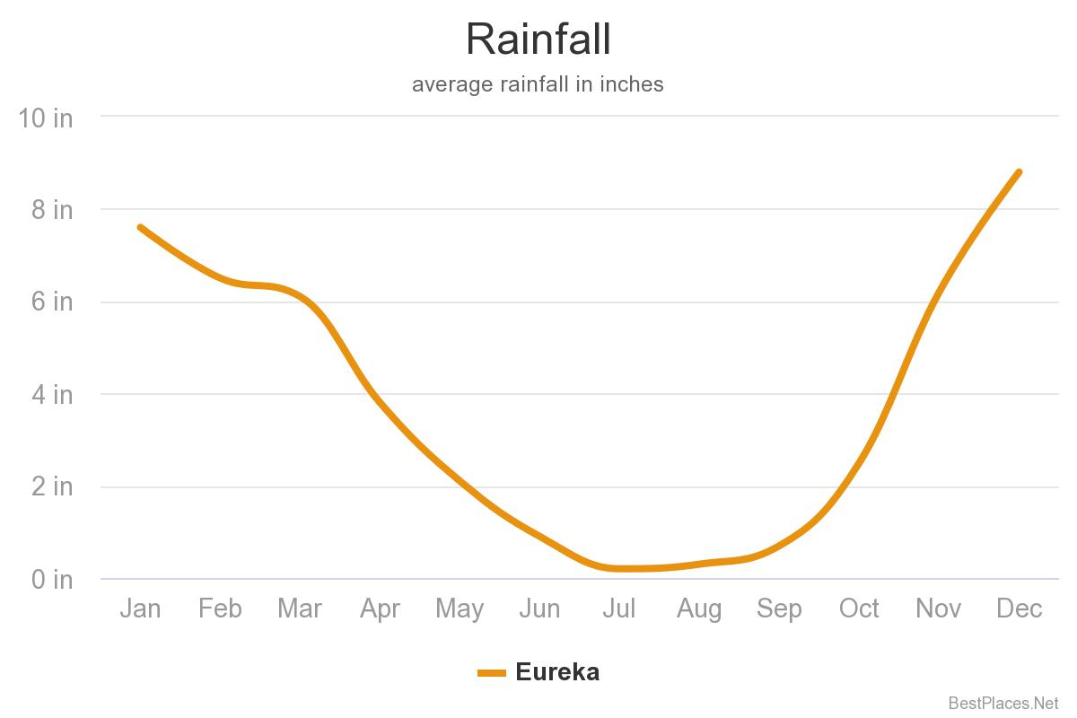
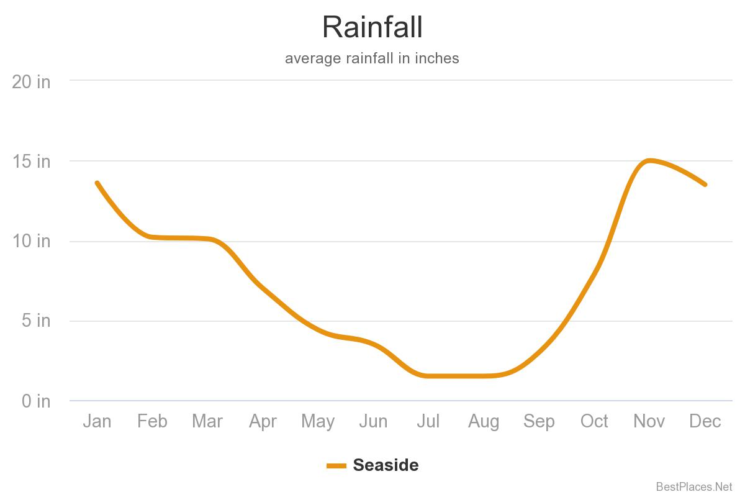
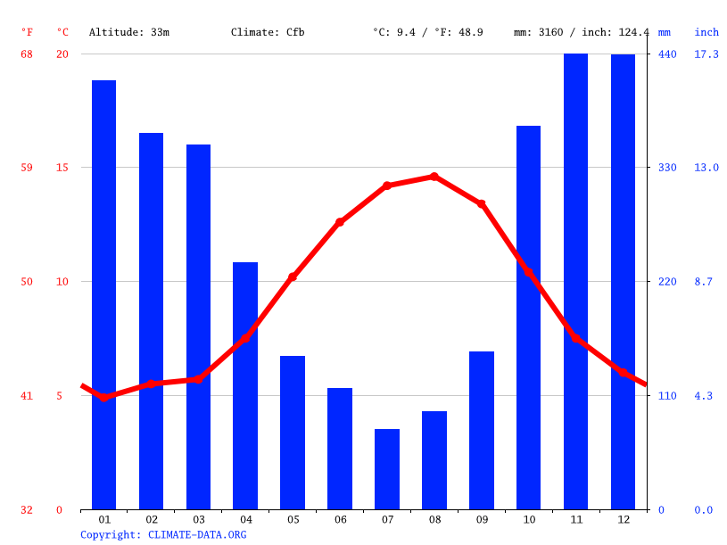
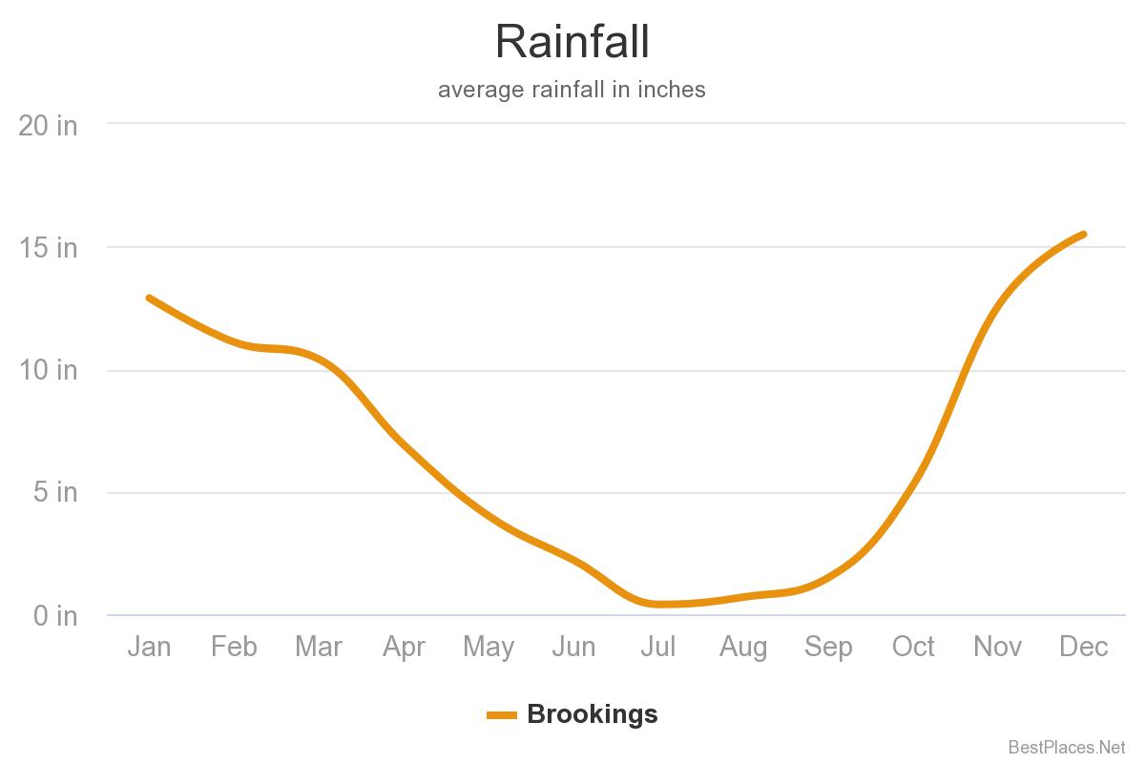
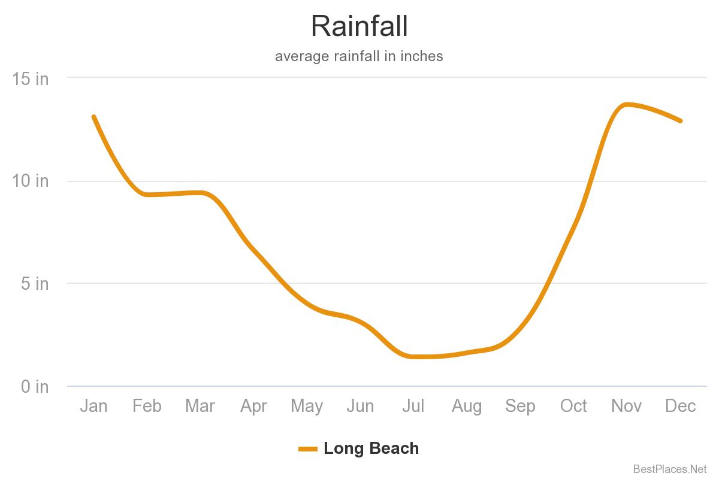
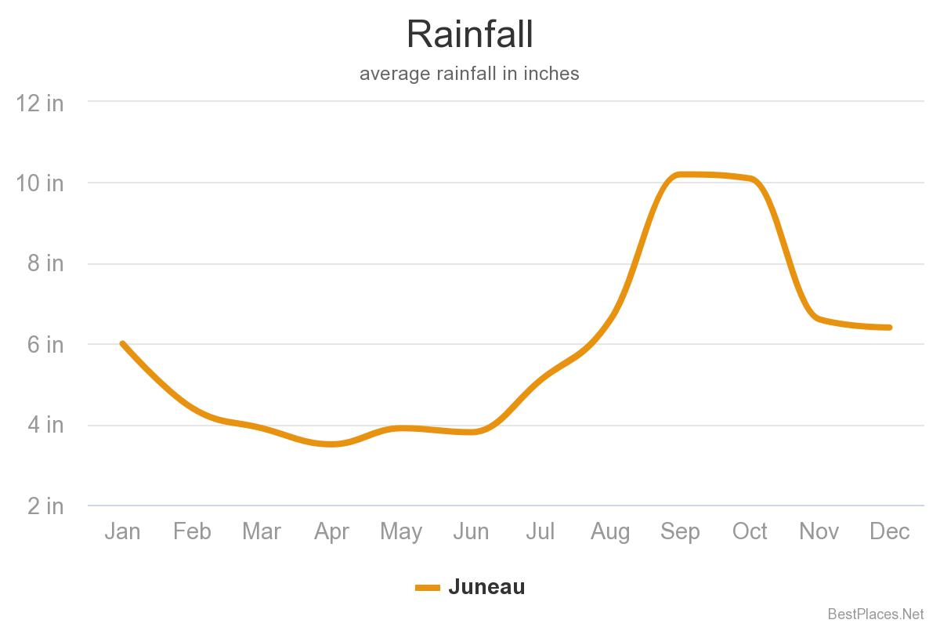
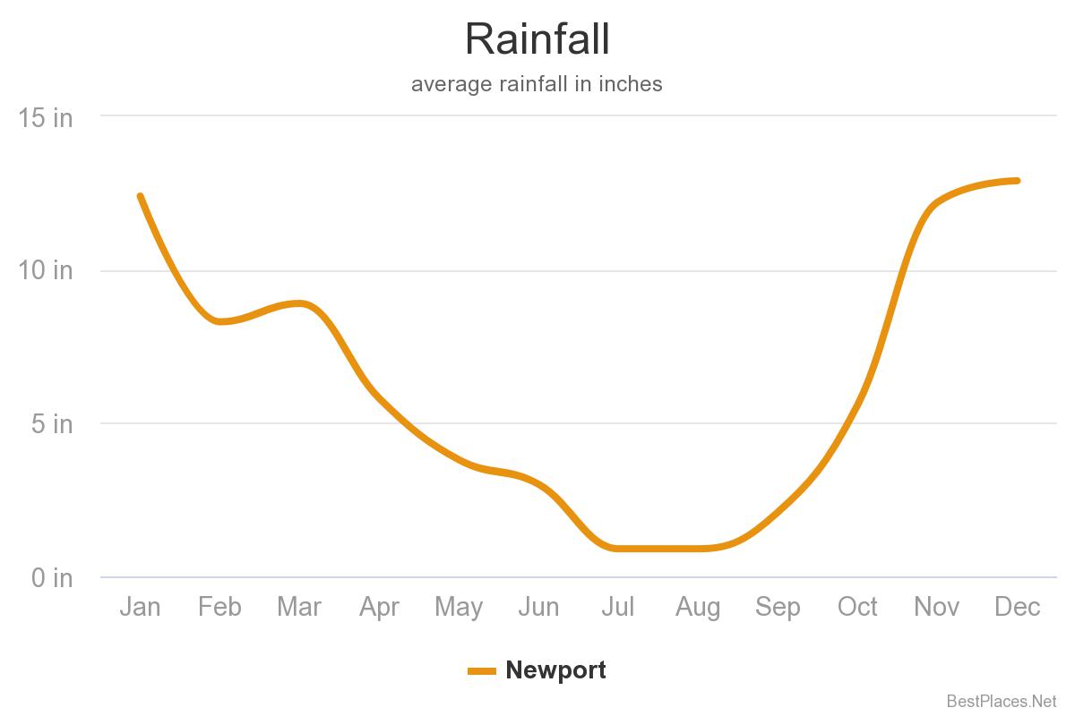
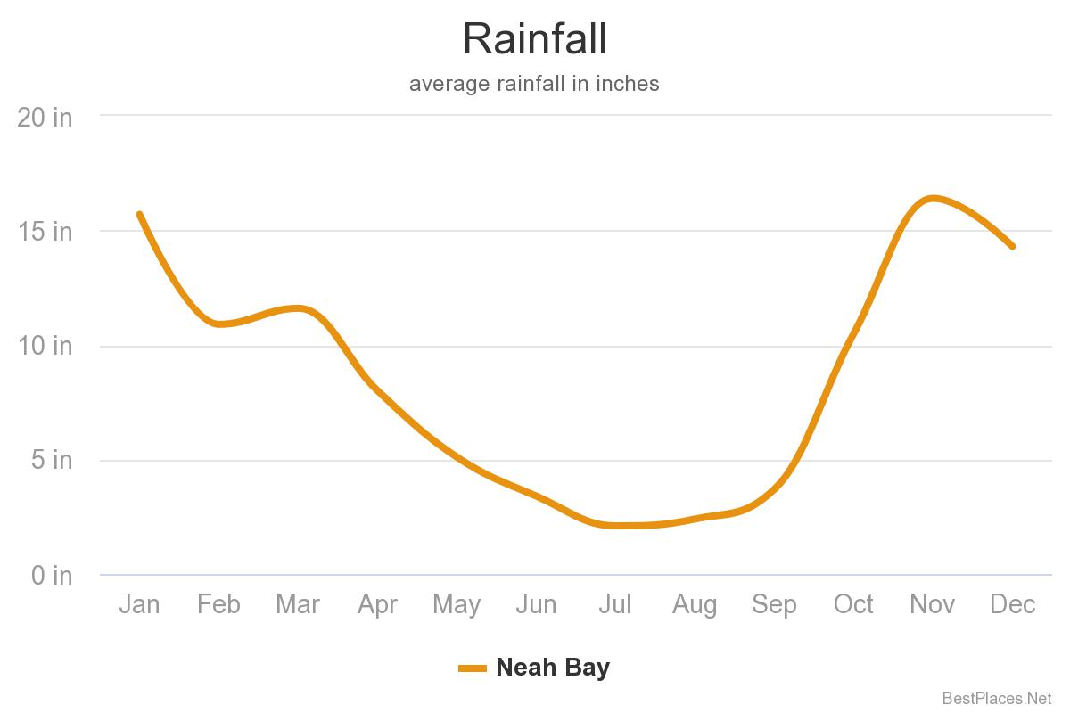
N. CA to Cent OR
N OR to N WA
BC to Juneau AK
Tofino precip

Slide 11
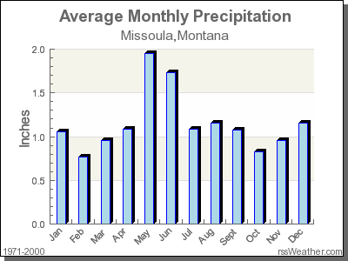
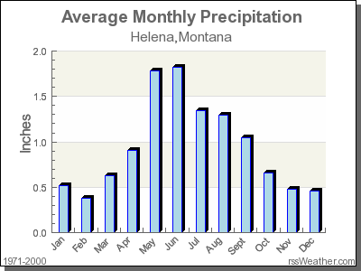
Precipitation Seasonality East of Cascades (ignore the audio part about misplaced Missoula slide, its now there)
In Columbia River Watershed of WA, OR, ID:
But Missoula MT, still west of Continental Divide, looks more like Helena MT, definitely E of Divide with strong spring max.
Still winter max, summer min, like west side, but
Typical spring secondary max, caused by heated surface convection: Cent & E WA, N. ID, interior OR (except SE & S Cent. (Basin & Range, with spring max.)

Slide 12
Summary: The west side winter wet summer dry pattern holds up well from N. CA past Vancouver Island, but not to Juneau
In areas between coastal mountains and Rockies, the pattern holds but with a spring secondary max in WA, OR & ID
Transitioning into the Rockies, in virtually all of BC, W Montana, W Wyoming, spring maximum pattern emerges, and is dominant
Fall 2020 students: the Mass reading focuses more on geographic differences in precipitation: such as dry Medford and the Olympic rainshadow in W.
Washington

Slide 13
Juneau, AK in September, near the rainiest time of year (October: 8.3”)
Notes:
Juneau September 2003 July precip is 4.1”, January is 4.8 inches, Oct 8.3”

Slide 15
Mesoscale Circulations & Climates
Background: the battle between continental and marine air masses is mediated by topography.
Special cases:
Sea breeze systems and Pacific marine air intrusions of summer
Continental polar air outbreaks and related storms of fall & winter

Slide 16
Willamette
Valley

